Slide 1

AGB1211 – DESIGN THINKING
Department of Artificial Intelligence and Data Science
Academic Year: 2024 – 2025 (Odd Semester)
Year : II ND YEAR
Semester : III
Section : A
Date : 05/12/2024
PRESENTED BY
1. DEVIPRIYA S (2303811724322024)
2. DHARANIKA P (2303811724322025)
3. DHARSHINI P(2303811724322026) 4. DHIVYA RUBIKA M (2303811724322028)

Slide 2
Title of the Project
VIRTUAL REALITY - BASED EDUCATION PLATFORM

Slide 3
Problem Identification
1. Accessibility Challenges
High Cost of Hardware: Many users may not afford VR headsets or compatible devices. Digital Divide: Unequal access to high-speed internet can hinder adoption in some regions.
2. Content-Related Issues
Limited Quality Content: Difficulty in creating diverse, high-quality VR content that covers various subjects effectively. Engagement Drop-Off: Risk of content being overly gimmicky or not aligned with educational goals.
3. User Experience Challenges
Motion Sickness: Some users experience discomfort or nausea in VR environments.Complexity of Use: Users, especially younger students or educators, may find VR interfaces difficult to navigate.

Slide 4
Objective
To develop a virtual reality app that offers an immersive and interactive experience for users. The app aims to create realistic virtual environments for enhanced engagement and usability. It will utilize advanced VR technology to meet the needs of [specific purpose, e.g., education, gaming, or training]. The focus is on delivering a seamless and intuitive user experience. By integrating innovative features, the app will provide users with a unique way to interact with virtual worlds, making tasks more efficient and enjoyable.

Slide 5
Brain Storming
ONLINE LEARNING
VIRTUAL LAB
REAL TIME FEEDBACK
INTERACTIVE CONTENT
LEARNING ANALYTICS
DIGITAL CLASSROOM
CONTENT CREATION
LIFE LONG LEARNING
DISTANCE EDUCATION
IMPRESSIVE LEARNING
GAMING EDUCATION
EDUCATION STIMULATION

Slide 6
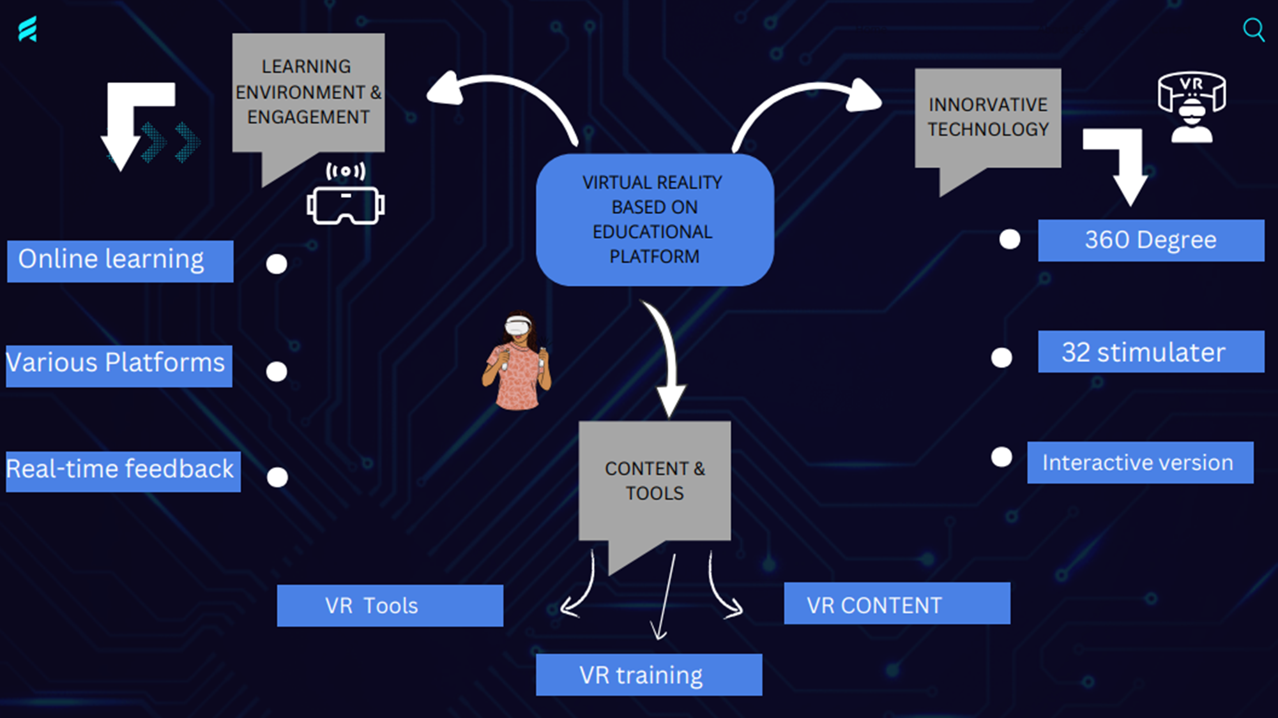
MIND MAP

Slide 7
Primary Research
1.Surveys and Questionnaires:
Target Audience: Students, educators, parents, and administrators. Key Questions: What challenges do you face in current education methods? What features would you expect in a VR-based learning platform?
2.Focus Groups
Organize sessions with small groups of students, teachers, or education experts to gather qualitative insights.
Topics for discussion: Benefits and concerns about VR in education.
3. User Testing
Develop a prototype and observe user interactions. Assess usability, engagement, and pain points. Example Metrics: Task completion time, ease of navigation, user satisfaction scores.

Slide 8
Secondary Research
1. Market Analysis
Study reports on the VR in education market (e.g., market size, growth rate, trends).Identify leading competitors and analyze their strengths and weaknesses.
2. Academic Studies
Review research papers on the effectiveness of VR in improving learning outcomes.Examples: Studies comparing VR-based learning vs. traditional methods.Research on VR's impact on memory retention and engagement.
3. Industry Reports
Sources: Gartner, Statista, McKinsey, or other market research firms.Focus on trends in edtech and VR adoption.

Slide 9
List of Modules
User Management ModuleFeatures
Content Management ModuleFeatures
Learning ModuleFeatures
Collaboration ModuleFeatures

Slide 10
Module Description
User Management ModuleFeatures:
User registration and login (students, teachers, admins).Profile customization (avatars, preferences).Role-based access control.
Content Management ModuleFeatures:
Upload and organize educational content (3D models, videos, simulations).Support for VR-ready formats (e.g., glTF, FBX).Categorization by subject, grade, or topic.Admin dashboard for managing content libraries.

Slide 11
Module Description
Learning ModuleFeatures:
Immersive 3D lessons (e.g., virtual labs, historical simulations).Interactive models for hands-on exploration (e.g., dissecting a virtual frog).Real-time quizzes and assessments within VR.Progress tracking and personalized learning paths.
Collaboration ModuleFeatures:
Virtual classrooms for group lessons.Real-time interaction using spatial audio and gestures.Collaboration tools (e.g., shared whiteboards, 3D model manipulation).

Slide 12
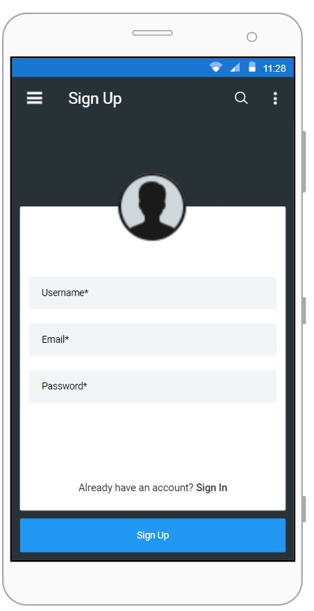
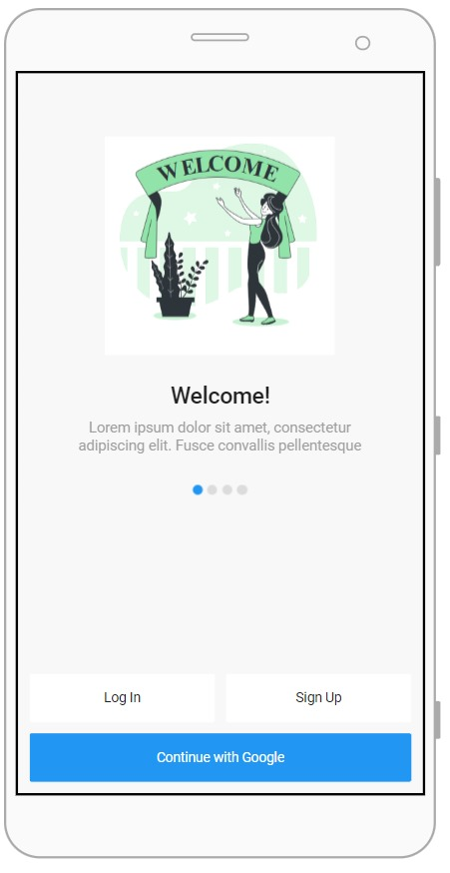
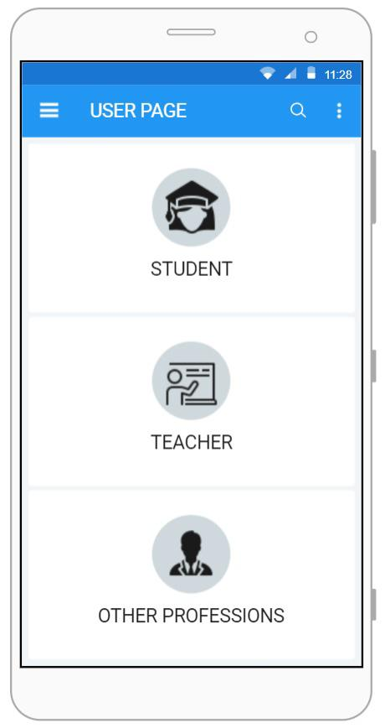
SCREENSHOT

Slide 13
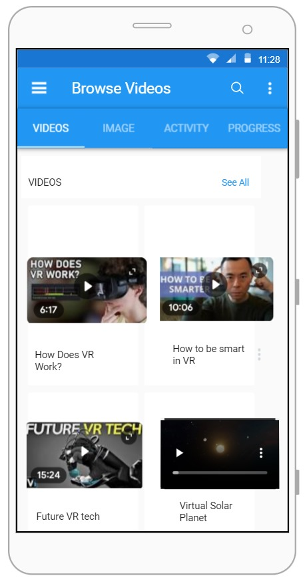
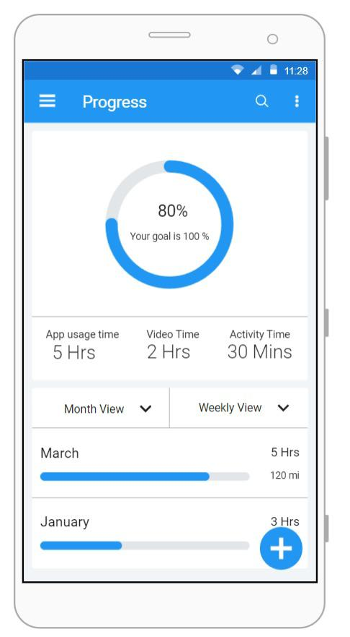
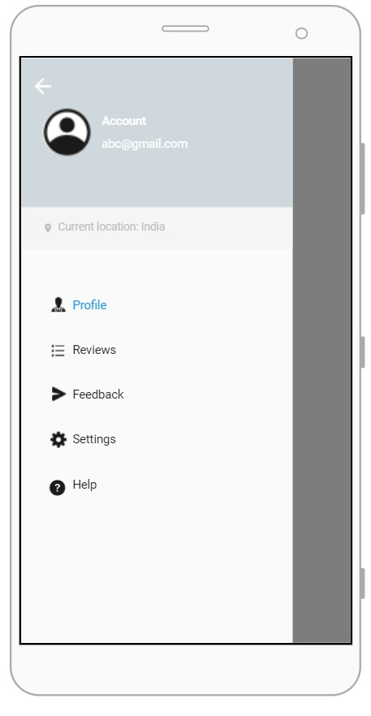
SCREENSHOT

Slide 14
Conclusion
The virtual reality app aims to revolutionize user experiences by creating immersive and engaging environments. By leveraging advanced VR technology, it provides innovative solutions for [specific purpose]. This app has the potential to transform how users interact with virtual spaces, offering practicality, entertainment, and convenience. With a focus on user-centric design and seamless functionality, the app sets the stage for future advancements in virtual reality applications

Slide 15
Thank You
Any queries???

